Slide 1

Dynamic Generation of Modular Industrial Plant Visualizations
Weekly Meeting 15
Miguel Romero Karam

Slide 2
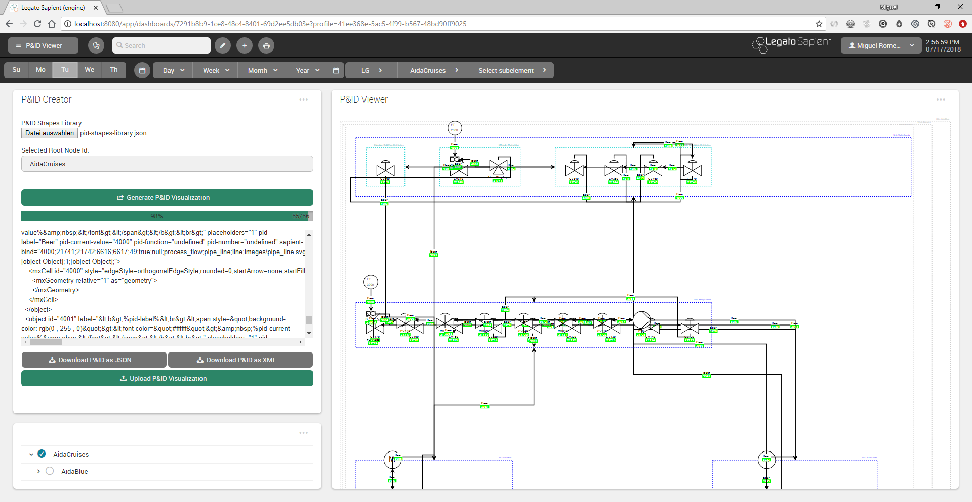
P&ID Viewer - Dashboard

Slide 3
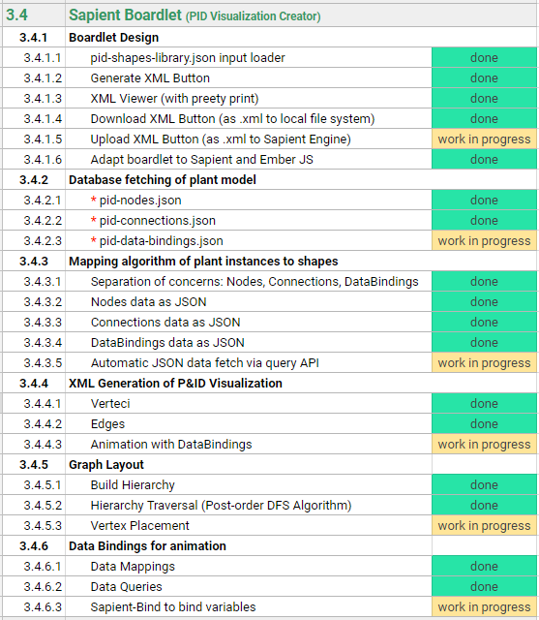
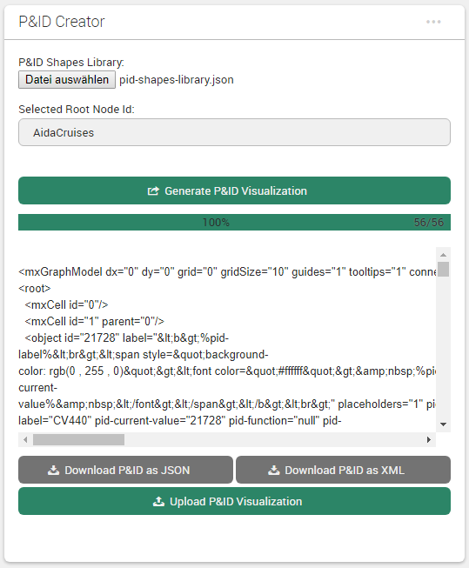
Sapient Boardlet Weekly Sprint 15

Slide 4
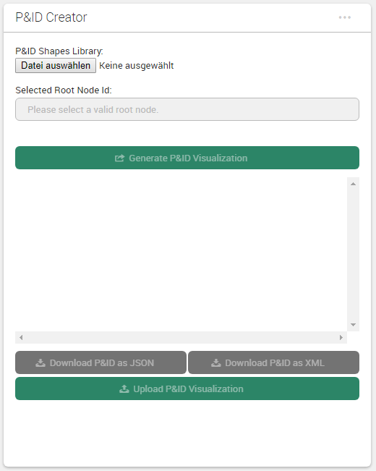
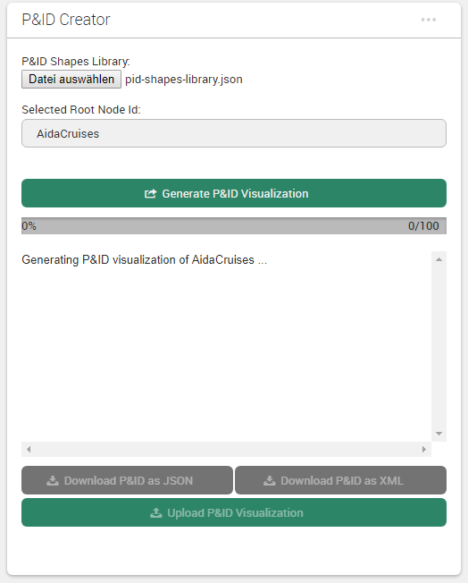
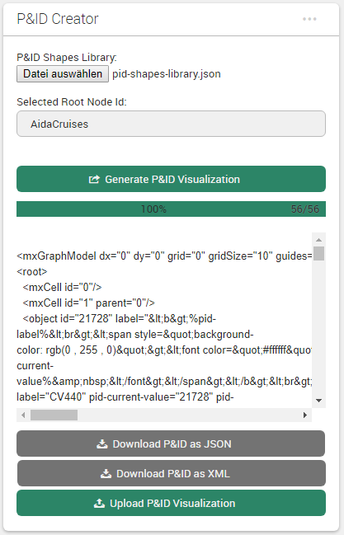
Boardlet Design Updates & Fixes
Implemented progress bar for vertex placement algorithm (can change to any function with iteration)
Fixed responsive layout of buttons when wrapped (narrow mobile screens)
1) on start
2) in progress
3) done
desktop
mobile

Slide 5
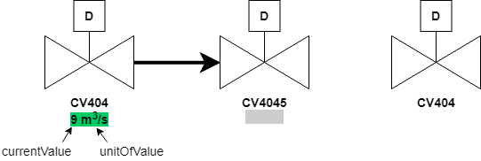
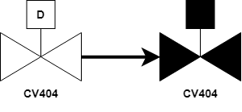
Data Bindings Overview
IDs of current values (primary key of p_values_current) stored in prj_prc_pro_flows under rate_value
Why are there only current values for flows ???
Only nodes with process variables have entry in p_values_current ???
Concept (getDataBindings):
Fetch IDs under rate_value along with query for pidConnections – done
For each ID: fetch and join p_values_config and p_values_current – done
Construct a sapientBind object for each rate_value depending on value type
ToDo:
Define data types: each data type (bool/int/float/string…) will have own sapientBind object for Example:
boolean (sets fillColor)
int (sets label) – concept because currently only bools
OR

Slide 6
Database Queries Overview Overview: Data Map
fetched
not needed (Legato Graphic Designer fetches current_values automatically with the ID) and current value will be the first non-blank value_[type] field
prj_prc_visu_vertices
l_nodes
p_value_relations
p_values_config
p_values_current
id [PK] : Int
id [PK] : Int
Maps to
id [PK] : Int
id [PK] : Int
id [PK] : Int
node : Int
node_level : Int
node: Int
value_type : Int
value_bool : Int
shape_name : String
node_type : Int
value: Int
value_format: Int
value_num : Double
is_instrument : Boolean
parent : Int
…
name_0: String
value_str : String
pid_label : String
short_name : String
value_symbol: String
value_date : Timestamp
pid_function : String
name_0 : String
prj_prc_pro_flows
unit: Int
time_stamp : Timestamp
pid_number : String
name_1 : String
…
last_archive_id : Int
description_0 : String
id [PK] : Int
last_update : Timestamp
visuVertices query
node0 : Int
description_1 : String
…
permissions : Int
node1 : Int
name_0
attr_jsonb : Jsonb
port0 : Int
TODO
Complex query to also get this together
p_value_types
modelId : Int
port1 : Int
DoState
isaLevel : String
product : Int
AoState
id [PK] : Int
valPrefix : String
is_continuous : Boolean
DiSens
name_0 : String
standingData: Array
rate_value : Int
AiSens
…
opcUALevel : Int
flow_type : String
AiValue
opcUANamespaceName : String
AiTemp
pidConnections query
opcUAAddressPrefix : String
…
lNodes query

Slide 7
lNodes and dataBindings Data Map of Query
not needed (Legato Graphic Designer fetches current_values automatically with the ID)
l_nodes
p_value_relations
p_values_config
p_values_current
id [PK] : Int
Maps to
id [PK] : Int
id [PK] : Int
id [PK] : Int
node_level : Int
node: Int
value_type : Int
value_bool : Int
node_type : Int
value: Int
value_symbol: String
value_num : Double
parent : Int
…
name_0: String
value_str : String
short_name : String
value_format: Int
value_date : Timestamp
name_0 : String
unit: Int
time_stamp : Timestamp
name_1 : String
…
last_archive_id : Int
description_0 : String
last_update : Timestamp
description_1 : String
…
permissions : Int
attr_jsonb : Jsonb
name_0
p_value_types
modelId : Int
isaLevel : String
DoState
id [PK] : Int
valPrefix : String
AoState
name_0 : String
standingData: Array
DiSens
…
opcUALevel : Int
AiSens
opcUANamespaceName : String
AiValue
opcUAAddressPrefix : String
AiTemp
…
lNodes query

Slide 8
lNodes and dataBindings PostgreSQL Query
Query data for data bindings and animations along with l_nodes:
SELECT n.id, n.node_level, n.parent, n.short_name, n.name_0, n.attr_jsonb, r.id, r.node, r.value, c.id, c.value_type, c.value_format, c.unit, c.value_symbol, c.name_0, t.id, t.name_0
FROM sapient_owner.l_nodes AS n
LEFT JOIN sapient_owner.p_value_relations AS r ON n.id = r.node
LEFT JOIN sapient_owner.p_values_config AS c ON r.value = c.id
LEFT JOIN sapient_owner.p_value_types AS t ON c.value_type = t.id
WHERE n.id >= 21691 AND n.id <= 21747
[ORDER BY n.id ASC]

Slide 9
visuVertices Data Map of Query
prj_prc_visu_vertices
l_nodes
id [PK] : Int
id [PK] : Int
node : Int
node_level : Int
shape_name : String
node_type : Int
is_instrument : Boolean
parent : Int
pid_label : String
short_name : String
pid_function : String
name_0 : String
pid_number : String
name_1 : String
visuVertices query
description_0 : String
description_1 : String
permissions : Int
attr_jsonb : Jsonb
modelId : Int
isaLevel : String
valPrefix : String
standingData: Array
opcUALevel : Int
opcUANamespaceName : String
opcUAAddressPrefix : String
…

Slide 10
visuVertices PostgreSQL Query
Query data for data bindings and animations along with l_nodes:
SELECT * FROM sapient_owner.prj_prc_visu_vertices
[ORDER BY id ASC]
Then in checkIfQueriesDone():
Join:
All queried lNodes (WHERE id >= rootID) and visuVertices with JavaScript
Filter:
in buildHierarchy() where only descendants of selectedRootNode are kept, rest is removed

Slide 11
pidConnections Data Map of Query
l_nodes
prj_prc_pro_flows
id [PK] : Int
id [PK] : Int
node_level : Int
node0 : Int
node_type : Int
node1 : Int
parent : Int
port0 : Int
short_name : String
port1 : Int
name_0 : String
product : Int
name_1 : String
is_continuous : Boolean
description_0 : String
rate_value : Int
description_1 : String
flow_type : String
permissions : Int
pidConnections query
attr_jsonb : Jsonb
modelId : Int
isaLevel : String
valPrefix : String
standingData: Array
opcUALevel : Int
opcUANamespaceName : String
opcUAAddressPrefix : String
…

Slide 12
visuVertices PostgreSQL Query
Query all flows:
SELECT * FROM sapient_owner.prj_prc_pro_flows
[ORDER BY id ASC]
Then in mapConnectionsToShapes():
Filter:
keep connections only if both target and id found in filtered vertices
Simplify:
Clear waypoints/wayports of edges (ex. shape1 --> group1 --> group2 --> shape2 simplified to shape1 --> shape1)
Map to shapes:
set shapeName property and map to corresponding edge shape in pid shapes library

Slide 13
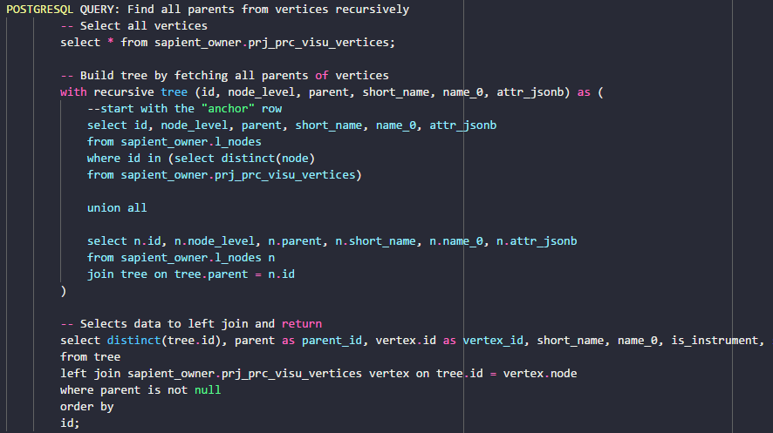
Database Queries Nodes Query - Problem
SQL- Query:
Complex SQL Query with LEFT JOIN not possible with getRecords options
Workaround with javascript:
2 distinct queries
Left Join Function in javascript on common attribute.
prj_prc_visu_vertices
l_nodes
id [PK] : Int
id [PK] : Int
node : Int
node_level : Int
shape_name : String
node_type : Int
is_instrument : Boolean
parent : Int
pid_label : String
short_name : String
pid_function : String
name_0 : String
pid_number : String
name_1 : String
description_0 : String
l_nodes
description_1 : String
Wanted Query Data
permissions : Int
attr_jsonb : Jsonb
visu_vertices
modelId : Int
isaLevel : String
valPrefix : String
standingData: Array
opcUALevel : Int
opcUANamespaceName : String
opcUAAddressPrefix : String
…
LEFT JOIN
ON tree.id = vertex.node

Slide 14
Vertex Placement Algorithm Overview
Simplification of edges (clear connection waypoints between various edges if any)
Jump
Constraint specification in the form of tags
Positioning logic in the form of rules (depending on tags)
Setting of parameters
forEach vertex in pidVertices:
if (not group):
calculate cell area
store cell area
position current vertex:
get previous vertex position (x, y values)
apply positioning rules
set current vertex position
update value of previous x, y values
else if (group):
sum areas of contained cells

Slide 15
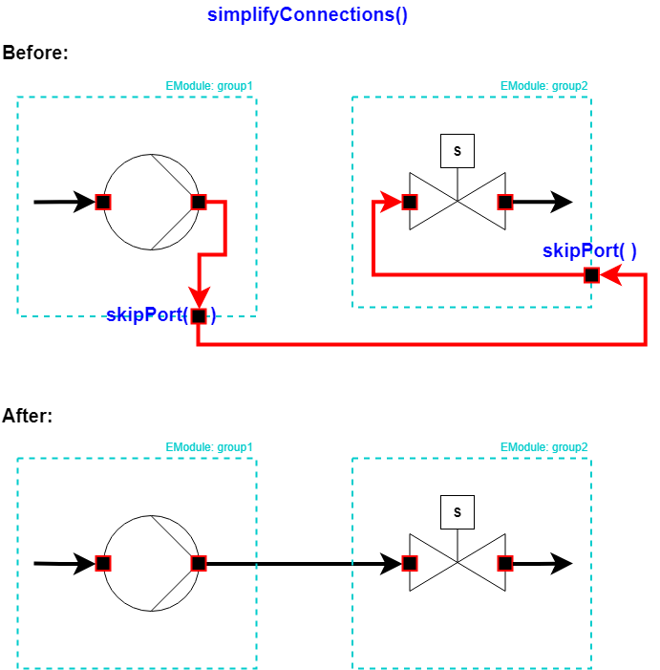
1. Simplification of Edges Overview
forEach edge in pidEdges:
if (already simplified):
skip
else if ()
calculate cell area
store cell area
position current vertex:
get previous vertex position (x, y values)
apply positioning rules
set current vertex position
update value of previous x, y values
else if (group):
sum areas of contained cells

Slide 16
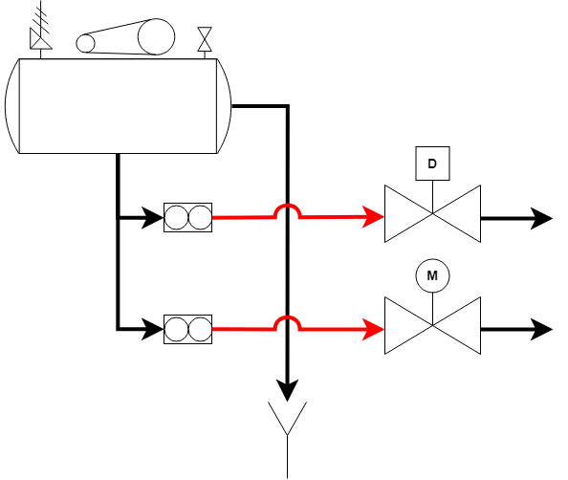
Line Jumps Example:
Problem:
Connections gehen vom Vertexmittelpunk zum Vertexmittelpunk
Connections werden automatisch optimiert um Kreuzungen zu vermindern aber unmöglich alle zu vermeiden
Dies führt zum Zusammenklappen verschiedene linen
Unübersichtlich
Lösung:
Line jumps
Arc form
radius 20pt

Slide 17
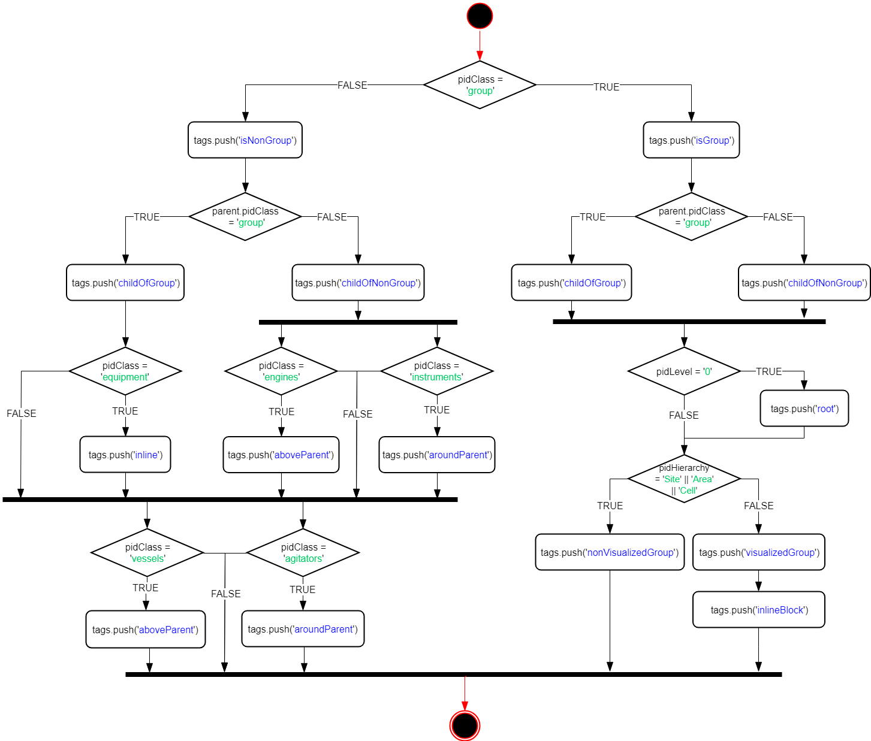
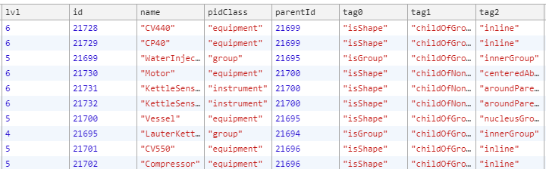
2. Constraint Specification Overview
Positioning Rules based on shape attributes:
Tags:

Slide 18
3. Vertex Placement Concept
Probleme:
Inkonsistenzen in das Model (Instance Hierarchy) wie z.B. Gruppen die Gruppen aber auch Shapes enthalten.
Führt zu Irreguläre Platzierung in die Mehrheit der Fälle → braucht zu viel Logik.
Relative positionierung deswegen manchmal suboptimal, aber trotzdem die beste Alternative
Viel Aufwand und wenig Fortschritt bei der Verbesserung des Algorithmus.
Lösungen (zum Teil):
Specification of Constraints erlaubt Logik gezielt zu programmieren
Constraints erlauben auch das progressive Enhancement
Block packing algorithm ist eine optimale Lösung für P&ID Diagramme falls alle children Gruppen sind (rechteckige Blocks). Nicht aber für shapes.

Slide 19
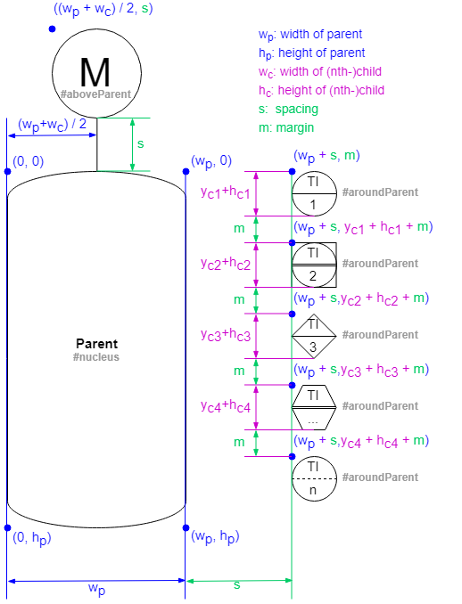
3.1 Placement Logic Example:
Kleine Modifikationen zum vorherigen Logik
Sonst gleich

Slide 20
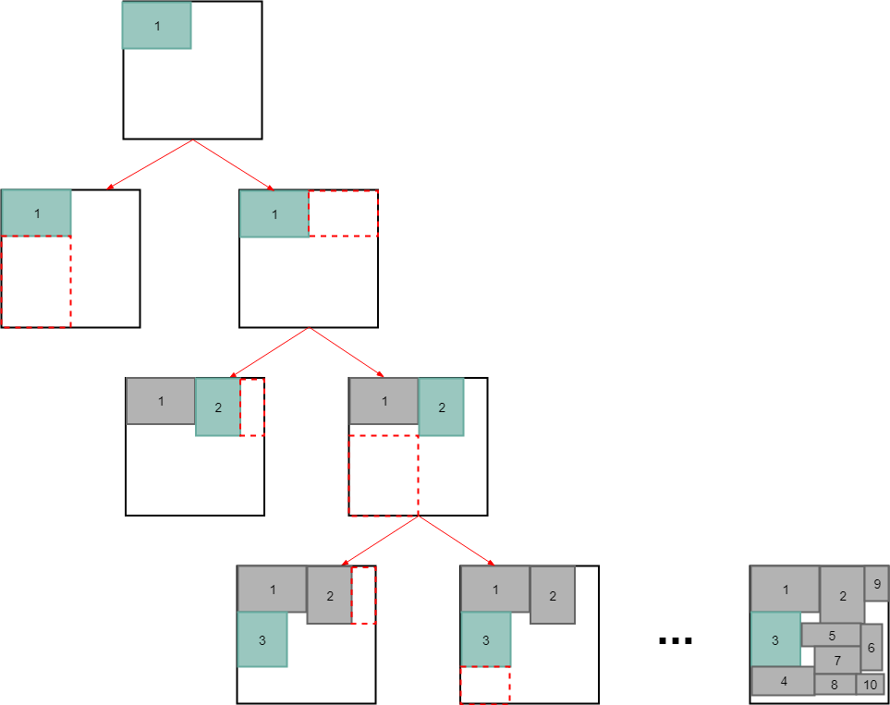
3.2 packBlocks() Overview
Binary tree block packing algorithm (for groups):
Sort blocks (clones) based on selected sortOrder option (none, width, height, area, maxSide)
Place first (root) block at (0, 0).
Place next block either right or bellow of previous (minimize area)
Repeat 3 until all blocks placed.
Update properties in original objects.
Sehr gute Ergebnisse für Blocks die nur Groupen sind (ohne Shapes)

Slide 21
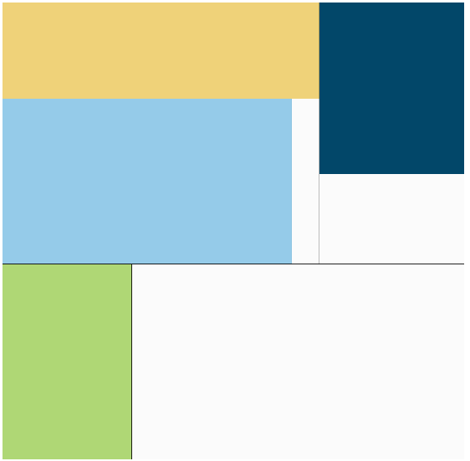
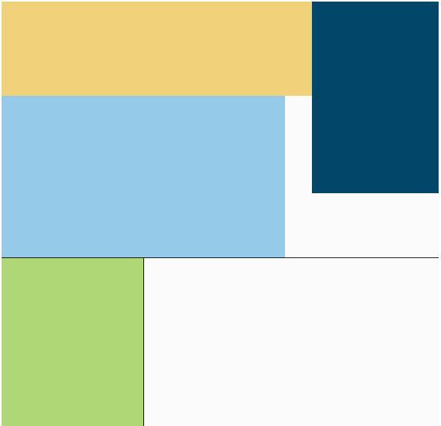
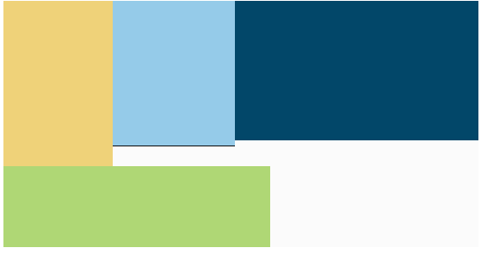
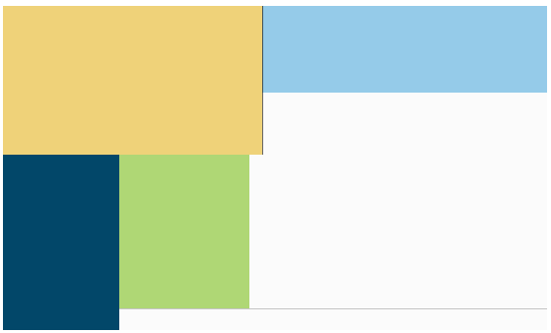
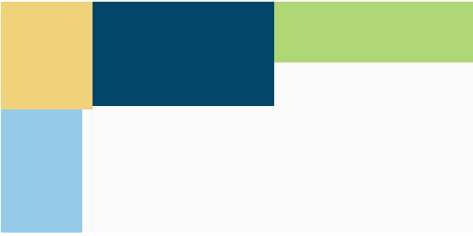
3.2 packBlocks() Sort Order Options
Beispiel mit 4 Units in Brewery (block dimensions to scale)
by height
none (default)
by area
by width
by maxSide

Slide 22
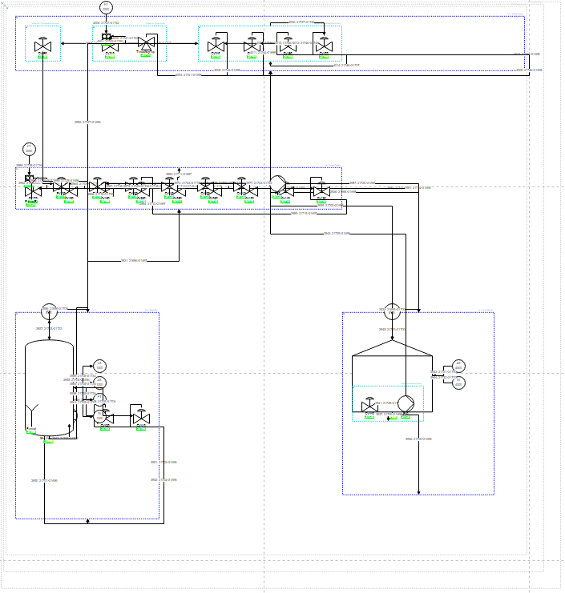
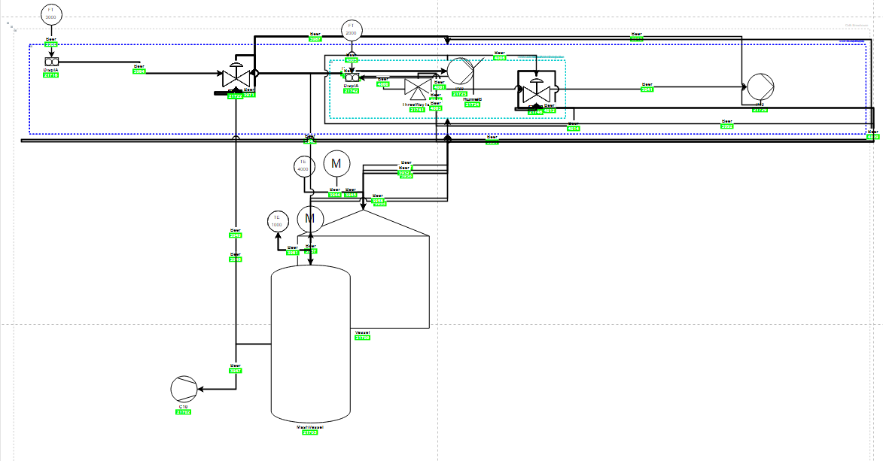
3.2 Bugs in Boardlet Algorithmus Sort Order Options
Obwohl praktish identische Code, nicht gleiche Visu Output.
Testing Boardlet Sapient Boardlet

Slide 23
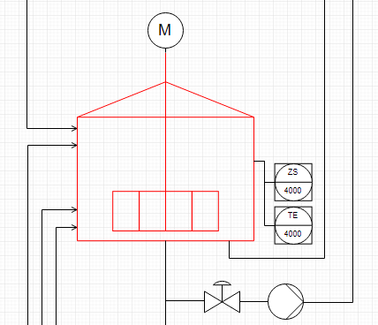

Vertex Placement Concept
Geometry between neighbouring children
$$x=w_{p}+s$$
y$=h_{p}−$ $h_{n}$
wn/2
Optimal Fall (vor ein Paar Wochen):
wp/2
(x, y)
hn/2
hp/2
(0, 0)
spacing
Hgmax (currently)
Wgmax (currently)
Relative Positioning
vertex placement group placement group placement … (recursively)
Parent vertex
(0, 0)
(-0.5,0.5)
(0.5, 0.5)
(1, 1)

Slide 24
3.3 Issues and Challenges Weekly Sprint 14
Stillstand beim vertexPlacement Algorithmus → fix bugs, then leave as is
Alles wofür es eine bestimmte Logik dahinter gibt, wird schon entsprechend dieser Logik platziert.
Nich viel mehr Logik um das Platzierungsalgorithmus in wenig Zeit noch zu verbessern.
Verbesserungen machen manchmal andere Teilen von Code kaputt.
Bugs im Algorithmus in Boardlet Script (nicht im Testing Boardlet).
Vorteile:
Konzentration auf Data-bindings (dynamisierung)
Verteci schon ziemlich gut platziert und edges vereinfacht
Verbesserungsmöglichkeiten direkt im draw.io (Drag&Drop)
Nachteile:
Platzierung ist das Endergebniss und alles was man am Ende sieht
Arbeit und Aufwand die hinter die Visualisierung sieht man nicht
Kann zu enttäuschenden Schlussfolgerungen bezüglich des Projekts führen
Bug wenn selectierte rootNode nicht AidaCruises → fix
Animations und Data Bindings
Process Variables noch nicht im Datenbank vorhanden → Animationen nur als Konzept
Model wird sowieso nur booleans enthalten → Konzept für andere Data Types oder nicht ?

Slide 25
Vorläufige Inhaltsverzeichnis Bachelorarbeit
In Word…

Slide 26
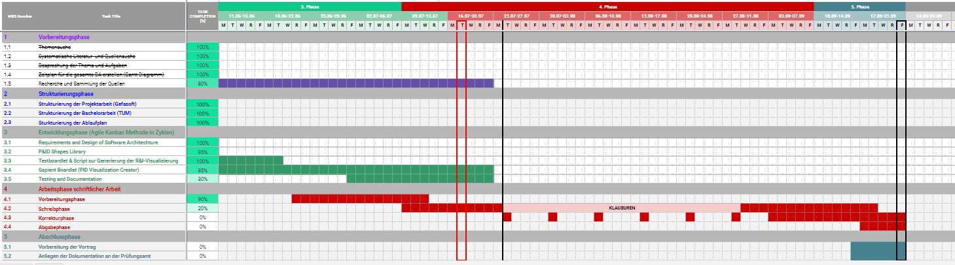
Project – Overview Overview of tasks: Week 10

Slide 27
forEach vertex in pidVertices:
if (not group):
calculate cell area
store cell area
position current vertex:
get previous vertex position (x, y values)
apply positioning rules
set current vertex position
update value of previous x, y values
else if (group):
sum areas of contained cells

